Slide 1
Teacher-Driven Learning Circles NYC Community of Adult Math Instructors (CAMI)
#nyccami
Eric Appleton, Tyler Holzer, Solange Farina, Mark Trushkowsky
CUNY Adult Literacy/HSE Program, Borough of Manhattan Community College & the Fifth Avenue Committee

Slide 2
Community of Adult Math Instructors (CAMI)
A group of teachers from different adult literacy and high school equivalency programs
Generalists who may not have a math background
Teach young adults and adults (17+)
Meet once a month to do math and talk about teaching

Slide 3
Our Goals
#nyccami
In this workshop, we hope participants will:
Experience the possibilities of a math teachers’ circle
Explore approaches to problem-posing and problem-solving
Learn from each other
And we hope that someone will leave here with the idea of starting their own circle...
Post questions, strategies and photos to this Twitter hashtag.

Slide 4
Problem Solving
A problem-solving approach to teaching math
Open-ended, non-routine problems
No obvious solution method
Multiple strategies
Multiple correct answers (sometimes)
One problem per meeting

Slide 5
“No matter how kindly, clearly, patiently, or slowly teachers explain, they cannot make students understand. Understanding takes place in the students’ minds as they connect new information with previously developed ideas, and teaching through problem solving is a powerful way to promote this kind of thinking.”
Lambdin, 2003*
*from Teaching Mathematics through Problem Solving, by Diana Lambdin

Slide 6
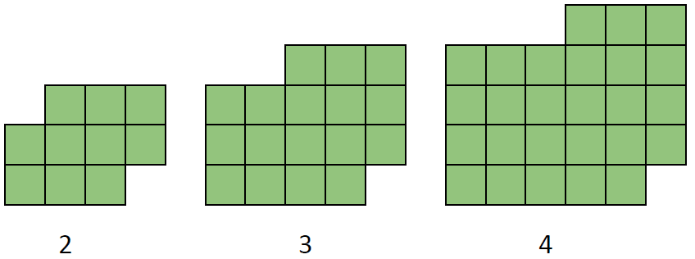
#nyccami
What do you notice?
Pose some questions.

Slide 7
Create a Poster with a Partner
First, write your question and your names. Your poster should show more than just your answer to the question you chose. Show your work/thinking as well.
When you’re finished, post on the wall. Take photos of your work and post to #nyccami.

Slide 8
Gallery Walk
Walk around and appreciate the posters we created. For as many as you can, post comments:
Things that you like
Questions you have

Slide 9
Math Teachers’ Circles
How is working on this problem relevant to our teaching?
What are the benefits of teachers working together in a math teachers' circle?
Deepen our mathematical understanding
Learn more than one way to solve problems
Prepare to understand student thinking
Experience productive struggle
Improve our teaching

Slide 10
Contact Us:
Eric · @eappleton · eric.appleton@cuny.edu
Solange · @stregasol · soul.farina@gmail.com
Tyler · @rezloh · tyler.s.holzer@gmail.com
Mark · @mtrushkowsky · mark.trushkowsky@cuny.edu
@nyc_cami · info@nyccami.org
Web Sites:
nyccami.org · MathMemos.org · CollectEdNY.org
Resources:
http://www.visualpatterns.org
http://www.mathteacherscircle.org

